Slide 1

Assignment 04 - Tools for Programming, Learning, and Collaboration
Build & Document a Mini Project Using GitHub and VS CodeNumber Guessing Game (Python)
Course Code
Programme
ETCCCP105
B.Tech CSE (AI and ML)
Semester
Faculty
1st Semester
Rajesh Kumar
Student Name:
Kunal Yadav
Enrolment Number:
2501730146
Submission Date:
23-10-2025
School of Engineering & Technology | Department of CSE | Session: Odd

Slide 2
1. Introduction and Project Overview
Modern software development has evolved beyond individual coding efforts into a collaborative, version-controlled discipline that demands proficiency in sophisticated development environments and tools. In today's technology-driven landscape, software engineers must not only write functional code but also manage it effectively across teams, track changes methodically, and maintain comprehensive documentation. The integration of development environments like Visual Studio Code, version control systems such as Git, and collaboration platforms including GitHub has become fundamental to professional programming practices. These tools enable developers to work efficiently, maintain code quality, collaborate seamlessly with peers, and contribute to projects of varying scales—from personal initiatives to enterprise-level applications.
This assignment aims to provide practical, hands-on experience with these essential tools through the development of a Number Guessing Game in Python. The project serves as an ideal introduction to professional development workflows, combining fundamental programming concepts with industry-standard practices. Students will gain exposure to integrated development environments, understand the importance of version control in tracking code evolution, and learn to leverage cloud-based repositories for code hosting and collaboration. Beyond technical skills, this assignment cultivates professional habits such as writing meaningful commit messages, maintaining structured documentation, and following coding standards.
The Number Guessing Game project encompasses several critical learning objectives. Firstly, students will master Visual Studio Code as their primary development environment, utilising its powerful features such as IntelliSense for code completion, integrated debugging tools, and extension support for enhanced productivity. Secondly, the assignment emphasises Git version control commands and workflows, teaching students to initialise repositories, stage changes, commit code with descriptive messages, and manage branches effectively. Thirdly, students will host their project on GitHub, understanding remote repository management, push operations, and the fundamentals of collaborative development. Finally, the assignment instils professional coding practices, including proper project structuring, comprehensive documentation writing, and adherence to Python coding standards. Through this multifaceted approach, students develop both technical competencies and professional behaviours essential for success in computer science careers.
01
02
Setup Development Environment
Develop the Game
Install and configure VS Code, Python, and Git on your system
Implement the Number Guessing Game with all required features
03
04
Version Control
Document & Deploy
Track changes using Git with meaningful commit messages
Create comprehensive documentation and host on GitHub

Slide 3
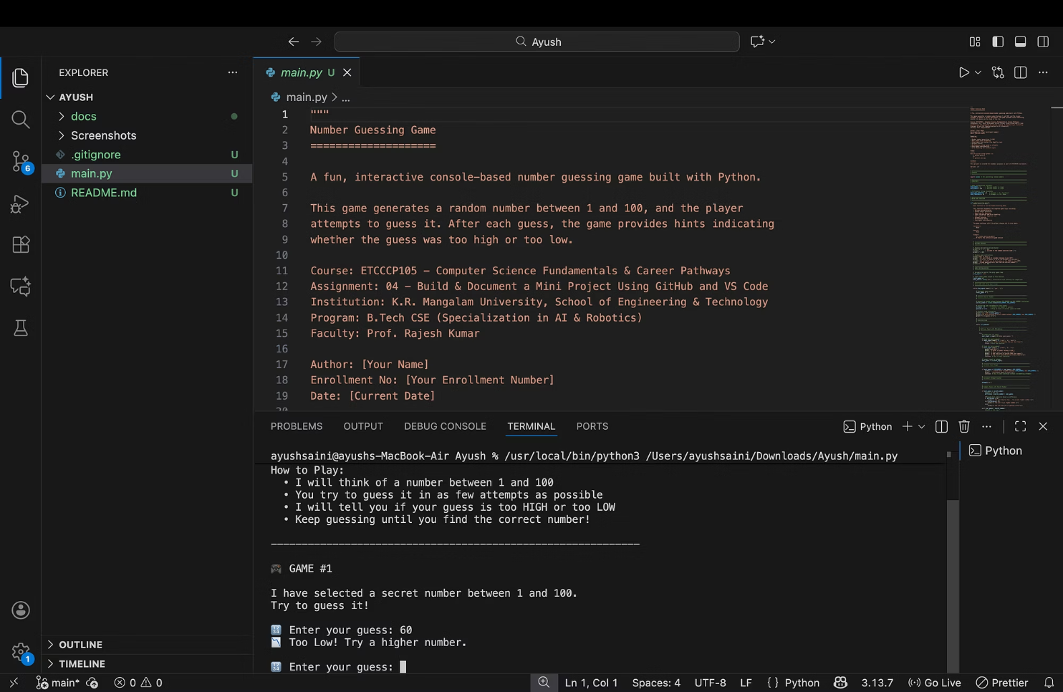
1.1 Project Description & Real-World Relevance
The Number Guessing Game
The Number Guessing Game represents a classic interactive console application that combines fundamental programming concepts with engaging user experience. At its core, the game generates a random number within a specified range—typically between 1 and 100—challenging the player to identify this secret number through strategic guessing. The application employs an intelligent hint system, providing feedback after each attempt by indicating whether the guess is "Too High" or "Too Low" relative to the target number.
The game loop continues iteratively until the player successfully identifies the correct number, at which point the application displays congratulatory messages along with comprehensive statistics about the player's performance. Key metrics include the total number of attempts required to solve the puzzle and a performance rating that evaluates the player's efficiency. To enhance replayability and user engagement, the application includes functionality allowing players to immediately start a new game session upon completion, maintaining their interest and providing opportunities for improvement.
1
Random Generation
Input validation mechanisms ensure robust operation, gracefully handling non-numeric entries and out-of-range values whilst providing clear feedback to guide users towards valid input. The interface employs decorative elements and structured output formatting to create an engaging user experience within the constraints of a console application. This combination of logic, user interaction, error handling, and feedback systems makes the Number Guessing Game an excellent pedagogical tool for understanding essential programming paradigms.
Creates unpredictable numbers between 1-100
2
Hint System
Provides intelligent feedback for each guess
3
Attempt Tracking
Monitors and displays player performance
4
Replay Option
Enables continuous gameplay sessions
Real-World Applications and Learning Value
The concepts embodied in this seemingly simple game have profound applications across numerous computing domains. Random number generation, as implemented here, forms the foundation for cryptographic systems, statistical simulations, procedural content generation in games, and machine learning algorithms requiring stochastic processes. Understanding how to generate and utilise random values programmatically opens pathways to more sophisticated applications in cybersecurity, data science, and artificial intelligence.
User input validation, another critical component, represents a universal requirement in software development. Every application that accepts user data—from web forms to mobile apps to enterprise systems—must implement robust validation to ensure data integrity, prevent security vulnerabilities, and provide meaningful error feedback. The techniques learned through implementing input validation in this game translate directly to professional development scenarios, including SQL injection prevention, cross-site scripting mitigation, and data sanitisation practices.
The implementation of loop and conditional logic structures develops algorithmic thinking—the ability to break complex problems into sequential steps and make decisions based on conditions. This fundamental skill underpins all programming paradigms and prepares students for more advanced topics including recursion, dynamic programming, and algorithmic complexity analysis. Furthermore, the game development aspect, whilst introductory, introduces concepts such as game state management, user interaction design, and feedback systems that scale to professional game development frameworks and interactive application design. Through this project, students cultivate problem-solving methodologies and computational thinking patterns that transcend the specific implementation, providing transferable skills applicable throughout their computing careers.

Slide 4



2. Development Tools and Environment Setup
Visual Studio Code
Git Version Control
GitHub Platform
Visual Studio Code (VS Code) serves as the integrated development environment (IDE) for this project, chosen for its lightweight architecture, extensive customisation capabilities, and robust Python support. Developed by Microsoft and released as free, open-source software, VS Code has rapidly become the most popular code editor amongst developers worldwide. Its appeal stems from a balance between simplicity and power—providing an intuitive interface for beginners whilst offering advanced features that satisfy experienced programmers.
Git represents the industry-standard distributed version control system, enabling developers to track changes in their codebase over time, collaborate with others, and maintain multiple versions of their projects simultaneously. Created by Linus Torvalds in 2005 for Linux kernel development, Git has become ubiquitous in software development, from individual projects to massive collaborative efforts involving thousands of contributors.
GitHub serves as the cloud-based hosting platform for Git repositories, providing remote storage, collaboration tools, and project management features. Acquired by Microsoft in 2018, GitHub hosts over 100 million repositories and serves as the primary collaboration platform for open-source projects worldwide. For this assignment, GitHub provides essential infrastructure for hosting the Number Guessing Game repository, making it accessible from any computer and demonstrating professional code sharing practices.
The fundamental Git workflow involves several key commands, each serving specific purposes in the version control process. The git init command initialises a new Git repository in the current directory, creating the hidden .git folder that stores all version control metadata. The git add command stages changes—selecting specific modifications to include in the next commit. This staging area allows developers to craft precise commits containing only related changes.
For Python development specifically, VS Code offers exceptional tooling through its official Python extension. IntelliSense provides intelligent code completion, suggesting methods, variables, and modules as you type, significantly reducing syntax errors and improving coding efficiency. The integrated debugger allows setting breakpoints, inspecting variables, and stepping through code execution line-by-line, facilitating rapid identification and resolution of logical errors. The built-in terminal enables executing Python scripts without leaving the editor, streamlining the development workflow.
Creating a repository on GitHub involves navigating to the platform, clicking "New Repository", and providing a repository name and optional description. The repository can be initialised with a README file, .gitignore template, and licence. Once created, GitHub provides URLs for connecting local Git repositories to the remote, using either HTTPS or SSH protocols for authentication.
The git commit command creates a snapshot of all staged changes, permanently recording them in the repository history along with a descriptive message explaining what changed and why. The git status command provides current repository state information, showing modified files, staged changes, and untracked files. The git log command displays commit history, allowing developers to review project evolution. The git push command uploads local commits to a remote repository, whilst git branch and git checkout enable working on multiple features simultaneously through branching and switching between branches.
The benefits of GitHub extend beyond simple backup. Version history preservation means every commit remains accessible indefinitely, allowing developers to review how code evolved, identify when bugs were introduced, and revert problematic changes. Collaboration features including pull requests, code reviews, and issue tracking facilitate team development. The platform's social aspects—starring repositories, following developers, contributing to open source—create networking opportunities and demonstrate coding abilities to potential employers. For students, GitHub serves as a portfolio showcasing their projects, skills, and commitment to professional development practices.
Additional extensions enhance productivity further: Pylance provides fast, feature-rich language support with type checking and auto-imports; GitLens supercharges the Git capabilities, offering blame annotations, commit history visualisation, and repository insights directly within the editor. The extensibility model means developers can customise their environment precisely to their workflow preferences, installing themes, key binding modifications, and language-specific tools as needed.

Slide 5


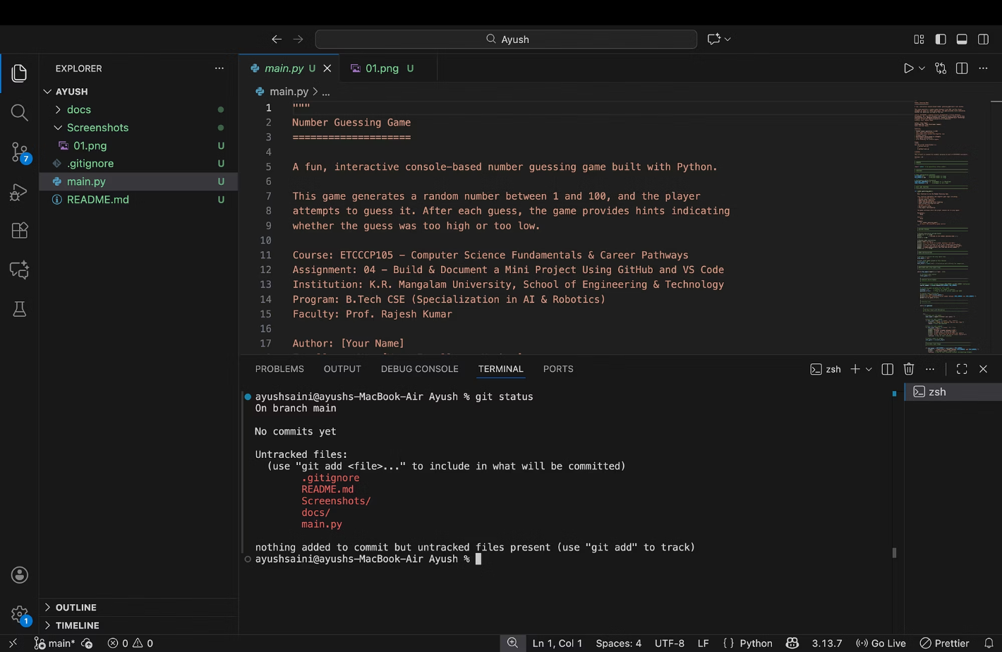


3. Source Code Implementation
Complete Python Implementation
The Number Guessing Game implementation demonstrates fundamental Python programming concepts whilst maintaining clean, readable code structure. The application begins by importing the random module, Python's standard library tool for generating pseudo-random numbers. This module provides various functions for random selection, number generation, and sampling operations essential for games, simulations, and statistical applications.
Random Module
Generates unpredictable numbers using Python's random.randint() function
The main game logic resides within the number_guessing_game() function, which encapsulates all game behaviour. This function-based approach promotes code organisation, reusability, and testing. The docstring immediately following the function definition provides documentation explaining the function's purpose, behaviour, and usage—a professional practice that aids code maintenance and collaboration.
Game Loop
Implements while loops for replay and guessing functionality
Error Handling
Try-except blocks validate input and handle exceptions gracefully
Rating System
Evaluates performance based on attempts with conditional logic
import randomdef number_guessing_game(): """ Main function to run the Number Guessing Game. Generates a random number and allows the user to guess until correct. """ print("=" * 50) print(" WELCOME TO THE NUMBER GUESSING GAME") print("=" * 50) play_again = 'yes' while play_again.lower() in ['yes', 'y']: # Generate random number between 1 and 100 secret_number = random.randint(1, 100) attempts = 0 guessed = False print("\nI have selected a number between 1 and 100.") print("Try to guess it!\n") while not guessed: try: # Get user input user_guess = int(input("Enter your guess: ")) attempts += 1 # Validate range if user_guess < 1 or user_guess > 100: print("Please enter a number between 1 and 100.") continue # Check guess if user_guess < secret_number: print("Too Low! Try again.") elif user_guess > secret_number: print("Too High! Try again.") else: guessed = True print(f"\nCongratulations! You guessed the number in {attempts} attempts.") except ValueError: print("Invalid input! Please enter a valid integer.") # Ask if the user wants to play again play_again = input("\nDo you want to play again? (yes/no): ") print("\nThank you for playing! Goodbye!")# Start the gameif __name__ == "__main__": number_guessing_game()

Slide 6
4. Git Version Control and GitHub Repository
Repository Initialisation
1
Created local Git repository and connected to GitHub remote using git init and git remote commands
2
Initial Structure
Committed basic project setup with main.py file structure and documentation placeholders
Core Features
3
Implemented and committed game logic, random generation, and basic loop structure
4
Enhancement Phase
Added validation, hints, attempt counter, and rating system across multiple commits
Documentation
5
Created comprehensive README, added .gitignore, and finalised repository structure
6
Deployment
Pushed all commits to GitHub main branch and verified remote repository
Comprehensive Commit History
Professional version control practices emphasise creating meaningful, atomic commits—each commit should represent a single logical change with a descriptive message explaining what changed and why. This assignment requires minimum five commits demonstrating progressive development. The following commit history illustrates proper Git workflow with descriptive messages following conventional commit format conventions.
Commit #
Commit Message
Description
1
Initial commit: Project structure setup
Created basic project structure with main.py file, established repository foundation, and configured initial Python environment settings
2
Add random number generation and basic game loop
Implemented core game logic with random module for number generation, created main game loop structure, and added basic user input functionality
3
Implement user input validation and error handling
Added try-except blocks for robust error handling, implemented input validation to ensure numeric values, and provided meaningful error messages for invalid input
4
Add hint system and attempt counter
Implemented "Too High" and "Too Low" feedback mechanism, created attempt tracking functionality, and integrated conditional logic for guess comparison
5
Add play again feature and performance rating
Developed replay functionality allowing continuous game sessions, implemented performance rating system based on attempt counts, added decorative output elements
6
Add README.md and comprehensive documentation
Created detailed README with project description, installation instructions, usage guidelines, and feature documentation following markdown best practices
7
Add .gitignore and finalise project structure
Added .gitignore to exclude Python cache files and virtual environments, organised documentation into docs folder, cleaned repository structure
Essential Git Commands
Repository Structure
The development process employed numerous Git commands, each serving specific version control functions. Repository initialisation began with git init, creating the local repository infrastructure. The git remote add origin [url] command connected the local repository to the GitHub remote, establishing the relationship between local and cloud-based code storage.
number-guessing-game/│├── main.py├── README.md├── .gitignore│└── docs/ ├── project_overview.md ├── development_process.md └── future_improvements.md
Staging and committing followed an iterative cycle: git add . staged all changes in the working directory, whilst git add main.py staged specific files when granular control was needed. Each git commit -m "message" created permanent snapshots with descriptive messages. The git status command regularly verified repository state, showing modified, staged, and untracked files.
Branch management used git branch -M main to rename the default branch to "main" following modern naming conventions. Finally, git push -u origin main uploaded all local commits to GitHub, with the -u flag establishing the upstream tracking relationship for future pushes.
The repository structure follows professional project organisation standards. The root directory contains the main application file (main.py), comprehensive README documentation, and Git configuration files. The docs/ subdirectory houses additional markdown documentation covering project overview, development methodology, and planned enhancements—separating detailed documentation from primary project files whilst maintaining accessibility.

Slide 7
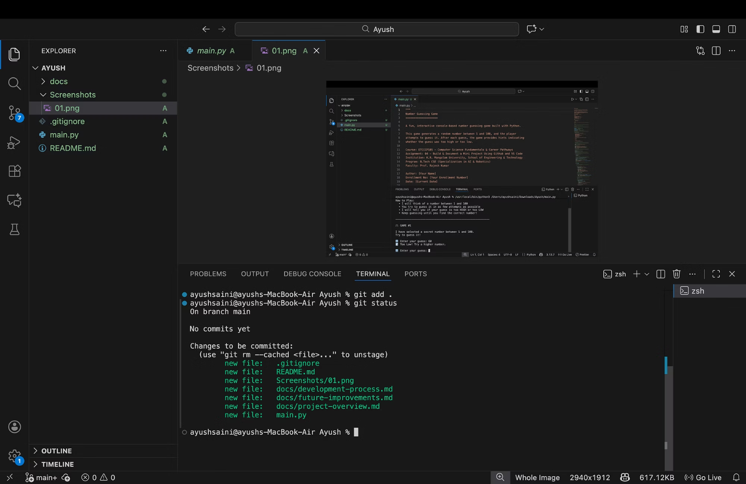
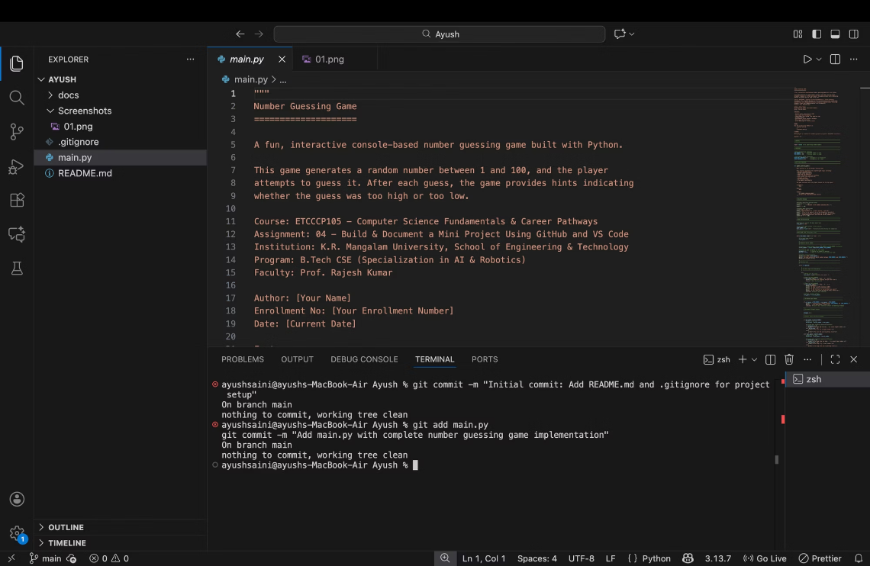
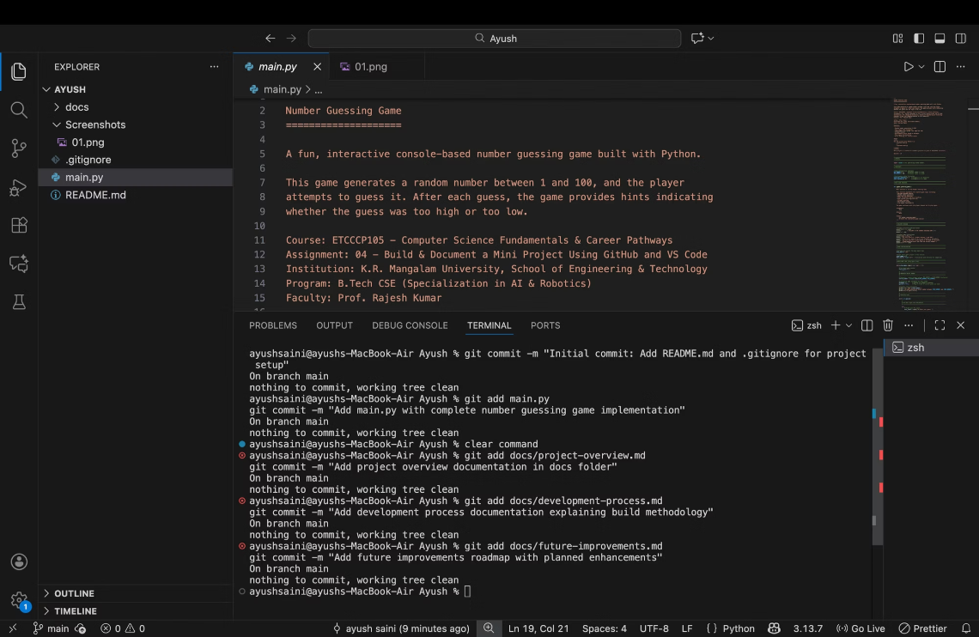
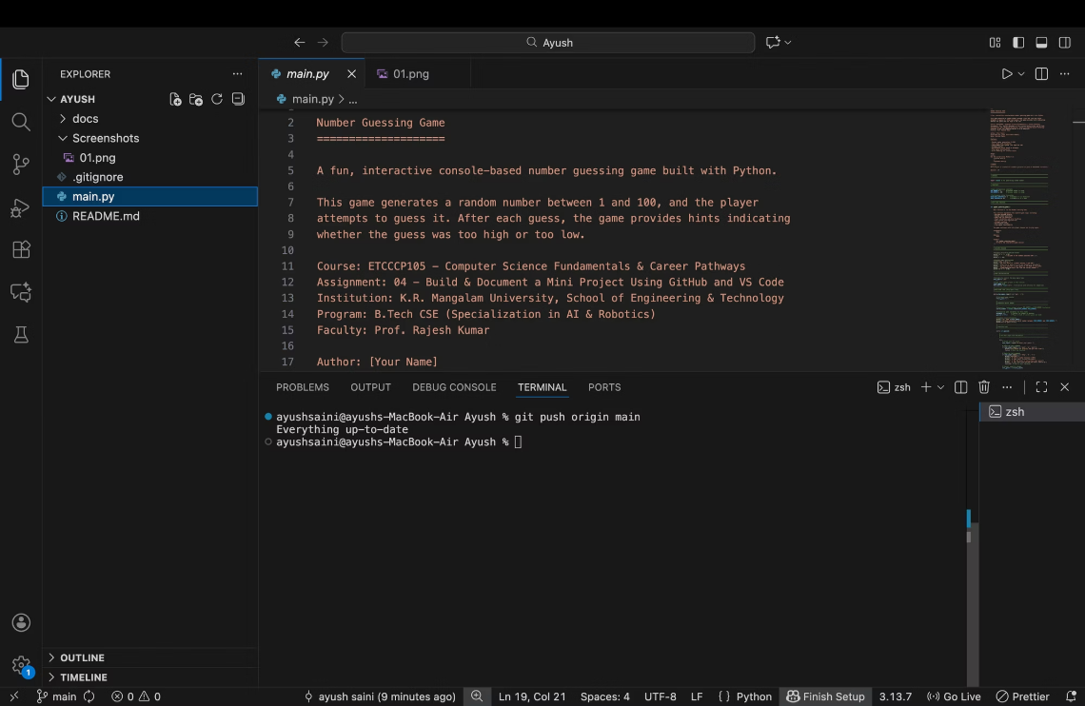
5. Documentation and Professional Practices
README.md: Project Gateway
The README.md file serves as the primary entry point for anyone encountering the project, whether collaborators, potential employers reviewing portfolios, or other developers exploring the codebase. Markdown formatting enables rich text presentation including headings, lists, code blocks, and links whilst remaining plain text and version-control friendly. A well-crafted README immediately communicates project purpose, functionality, and usage instructions, significantly improving project accessibility and professionalism.
The Number Guessing Game README begins with an engaging title enhanced by emoji icons that add visual interest and personality. The description section provides a concise overview of the project's purpose and core functionality, establishing context for readers. The features section employs bullet points to highlight key capabilities including random number generation, the hint system, attempt tracking, performance ratings, replay functionality, error handling, and user interface design. This structured presentation allows readers to quickly grasp project scope and complexity.
Title & Description
1
Engaging project introduction with clear purpose statement
Installation instructions offer step-by-step guidance for setting up the project locally: cloning the repository using git clone, navigating to the project directory, and verifying Python installation. Usage instructions demonstrate executing the game with the python main.py command. The "How to Play" section provides user-facing documentation explaining gameplay mechanics—a consideration often overlooked in technical projects but crucial for user experience.
2
Features List
Bullet-point highlights of key capabilities and functionality
Placeholder sections for screenshots enable visual demonstration of the application once captured. The author section attributes the work appropriately, whilst the licence section clarifies usage rights—in this case, acknowledging academic purposes under the ETCCCP105 coursework. This comprehensive README structure exemplifies professional documentation standards that enhance project credibility and usability.
3
Installation Guide
Step-by-step setup instructions for local development
4
Usage Instructions
Clear commands and gameplay mechanics explanation
5
Attribution & Licence
Author information and usage rights clarification
.gitignore: Repository Cleanliness
The .gitignore file instructs Git which files and directories to exclude from version control, preventing clutter and security risks in the repository. Python projects generate numerous temporary and compiled files that should never be committed: bytecode files in __pycache__/ directories, compiled .pyc files, virtual environment directories (venv/, env/), and IDE-specific configuration folders like .vscode/ and .idea/. Operating systems create metadata files such as .DS_Store on macOS and Thumbs.db on Windows that provide no value in repositories. Log files, distribution artifacts, and environment variable files (.env) containing sensitive information must also be excluded. A comprehensive .gitignore maintains repository cleanliness, reduces repository size, prevents accidental exposure of sensitive data, and avoids merge conflicts in generated files.
Project Overview Document
Development Process Documentation
Future Improvements Roadmap
The project_overview.md file in the docs/ folder provides expanded context beyond the README, including detailed objectives, technical specifications, target user identification, and comprehensive project scope documentation. This separation allows the README to remain concise whilst making detailed information available for those requiring deeper understanding.
The development_process.md chronicles the project lifecycle through distinct phases: planning, core development, feature enhancement, and polish. It documents tools and technologies employed, challenges encountered during implementation, and solutions applied to overcome obstacles. This retrospective documentation provides valuable learning material and demonstrates problem-solving approaches.
The future_improvements.md document outlines planned enhancements categorised by timeframe: short-term improvements like difficulty levels, medium-term goals including GUI development, and long-term aspirations such as web application conversion. This forward-looking documentation demonstrates strategic thinking, project vision, and commitment to continuous improvement whilst providing a roadmap for potential contributors.

Slide 8

6. Learning Outcomes, Reflection, and Conclusion
Technical Competencies Acquired
7
4
This assignment successfully developed numerous technical competencies essential for modern software development. Proficiency in Python programming fundamentals now encompasses understanding of data types, control structures (loops and conditionals), function definitions, module imports, exception handling, and user input processing. These foundational concepts provide the bedrock for advancing to object-oriented programming, data structures, algorithms, and specialised application domains.
Git Commits
Documentation Files
Meaningful commits tracking project evolution professionally
Comprehensive markdown files covering all project aspects
Visual Studio Code mastery includes navigating the interface efficiently, utilising IntelliSense for rapid code completion, leveraging integrated debugging tools to identify and resolve errors, managing extensions for enhanced functionality, and using the integrated terminal for seamless workflow. These IDE skills transfer to other development environments and significantly boost productivity in professional settings.
100%
8
Git version control understanding spans repository initialisation, change staging, commit creation with meaningful messages, branch management, remote repository interaction, and commit history navigation. Version control literacy represents a non-negotiable requirement in collaborative software development, enabling effective teamwork, code review participation, and contribution to open-source projects.
Error Handling
Core Features
Robust input validation preventing application crashes
Implemented game capabilities from random generation to ratings
GitHub repository management encompasses repository creation, README documentation, .gitignore configuration, project structuring, and understanding of collaborative features including issues, pull requests, and code reviews. Platform proficiency opens pathways to networking, portfolio building, and participation in the global developer community.
Professional Skills and Problem-Solving Development
Beyond technical abilities, this assignment cultivated essential professional skills and cognitive capabilities. Problem-solving approaches evolved through iterating on challenges such as implementing input validation, structuring game loops, and creating intuitive user experiences. The process of breaking complex requirements into manageable tasks, implementing solutions incrementally, testing functionality, and refining based on results mirrors professional software development methodologies.
Documentation writing skills improved substantially through creating the README, supplementary markdown files, code comments, and docstrings. Clear, concise technical writing enables knowledge transfer, facilitates collaboration, and demonstrates professionalism. These communication skills prove as valuable as coding abilities in team environments. Code organisation and project structuring developed through thoughtful file arrangement, logical separation of concerns, and adherence to naming conventions. Well-organised projects enhance maintainability, scalability, and collaboration potential.
Problem Identification
Research & Learning
Recognising challenges in input validation and game loop logic
Consulting documentation, tutorials, and examples for solutions
Implementation
Refinement
Applying learned concepts through iterative coding and testing
Improving code quality, adding features, and documenting thoroughly
Conclusion and Future Trajectory
This assignment successfully achieved all specified objectives, delivering a functional Number Guessing Game hosted on GitHub with comprehensive documentation and professional version control practices. The project demonstrates competency in Python programming, Visual Studio Code utilisation, Git version control, GitHub repository management, and markdown documentation. Through iterative development tracked across seven meaningful commits, the game evolved from basic structure to a feature-rich application with input validation, hint systems, attempt tracking, performance ratings, and replay functionality.
The importance of version control in software development cannot be overstated. Git enables tracking every code change, understanding project evolution, reverting problematic modifications, experimenting with new features safely through branching, and collaborating effectively with teammates through merge workflows. Professional developers rely on version control daily, making early mastery essential for career success. Similarly, proper documentation dramatically improves project value—well-documented code aids maintenance, facilitates collaboration, demonstrates professionalism, and enables knowledge sharing across time and teams.
This project contributes substantially to understanding professional development practices by simulating real-world workflows. Industry software development follows similar patterns: requirements analysis, environment setup, iterative development with version control, comprehensive testing, documentation creation, and deployment to accessible platforms. Experiencing this complete lifecycle builds confidence and preparedness for internships, collaborative coursework, and eventual employment in technology roles.
Personal reflection on this learning experience reveals significant growth in both technical skills and professional mindset. Initial challenges with Git commands and proper commit messaging yielded to understanding through practice and reference documentation consultation. Structuring comprehensive documentation initially seemed daunting but became manageable by following established markdown conventions and focusing on user needs. The satisfaction of seeing the complete project hosted on GitHub, accessible to anyone worldwide, provides motivation for tackling more ambitious projects.
Looking forward, this foundation enables progression to more complex endeavours: developing GUI applications using Tkinter or PyQt, creating web applications with Flask or Django, exploring data science with pandas and matplotlib, contributing to open-source projects on GitHub, or specialising in areas like machine learning, cybersecurity, or mobile development. The tools, workflows, and professional practices mastered through this assignment transfer directly to any programming domain, establishing a strong foundation for continued growth in computer science and software engineering careers. The confidence gained through successfully completing this comprehensive assignment confirms readiness for increasingly sophisticated technical challenges ahead.

